Slide 1
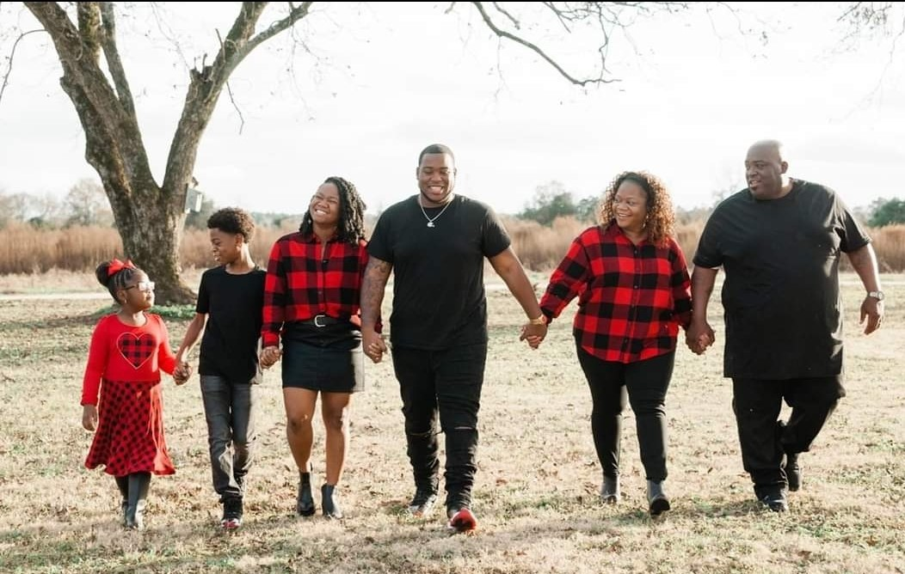
Mrs. Dorsey
Email: dorseta@boe.richmond.k12 .ga.us
Phone: (706)481-1813
Masters of Education
University of Phoenix
Bachelors of Arts in Sociology
Augusta University
Starbucks
Chick-Fil-A
Target
Scrapbooking
Manicures and Pedicures
Romance Novels
MY FAMILY
Reginald and I have a beautiful blended family of 6.
Maelyn, Austin, Aliyah, De’Quan. Missing is Jordan and De’Onte
I am thrilled to be your child’s teacher. I believe that children need to feel sate and love in order to take risks in learning. My goal is to create a family of learners in this classroom.

